Slide 2
Flight Controller for Autonomous Drones
Student: Supervisor(s):
Marcus Christiansen Søren Hansen
Nils Axel Andersen

Slide 3
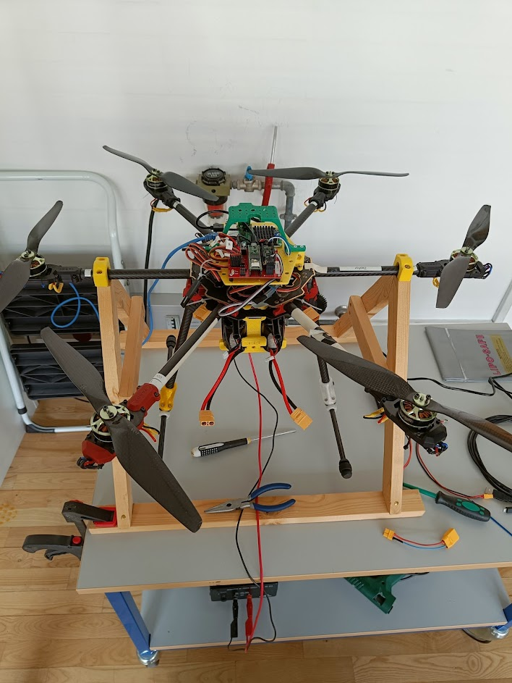
Task
Get this to fly by itself

Slide 4
Task
Known issues:
Unscheduled landing
Communication between teensy and Pi
Pitch & Roll attitude commands issue
Objectives:
Position & Velocity Control via OptiTrack
First in simulation
Next on the actual drone
Position & Velocity Control via Aruco
Camera based positioning

Slide 5
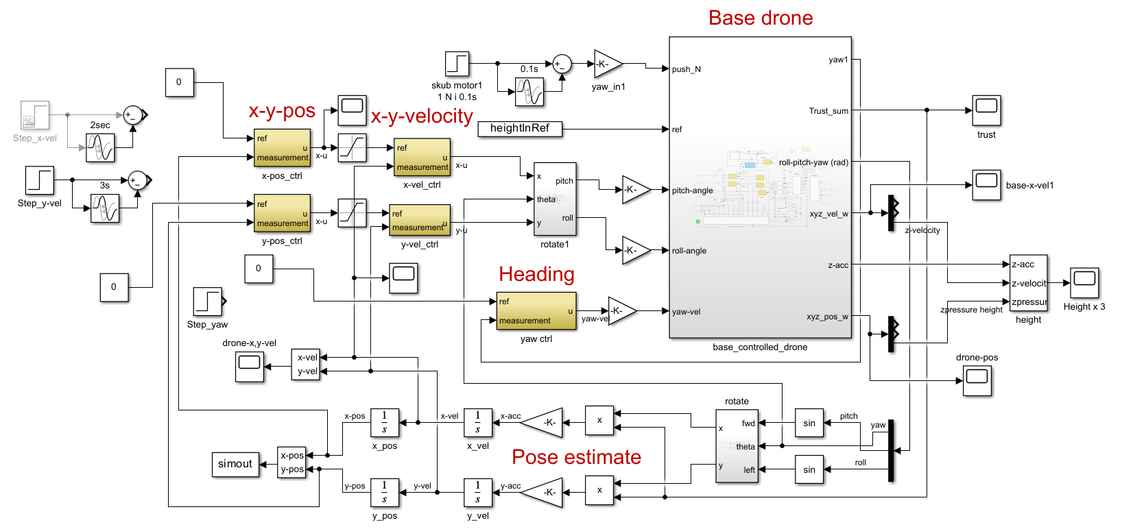
Simulation
Notes:
Cascading P PD Controller
PID for height (Currently a PD) – Inside drone
XY pos and XY Vel
Reason for Vel control – Allows a set max speed.

Slide 6
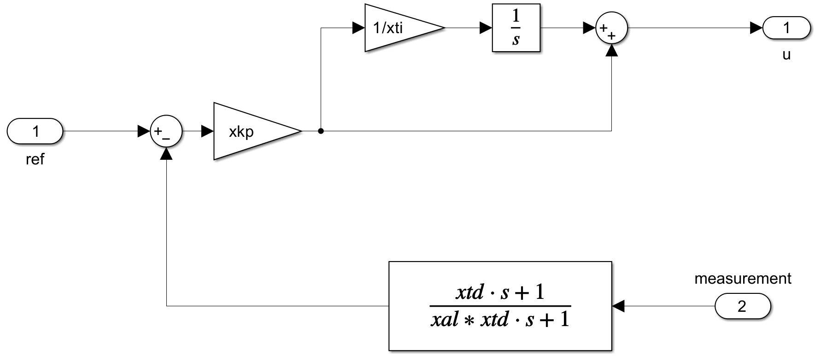
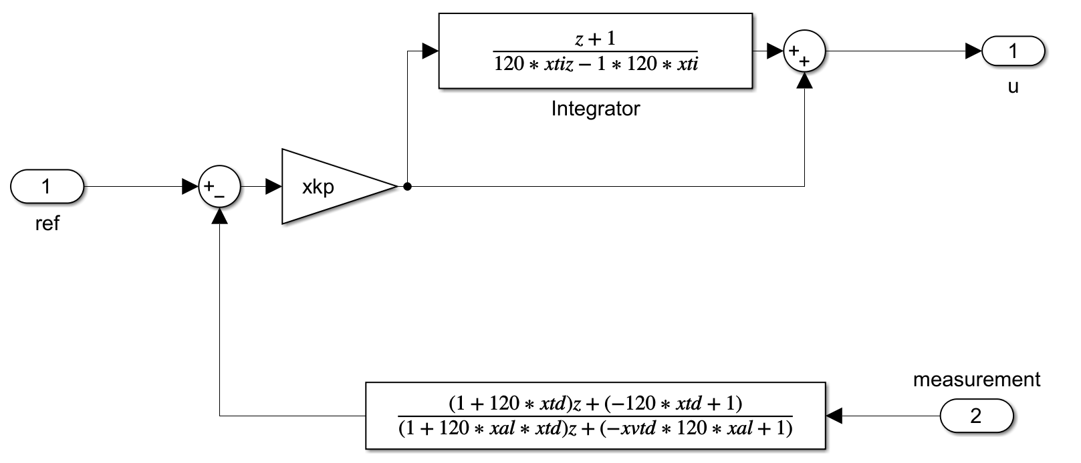
Simulation - Discretization
Biliniear transform

Slide 7
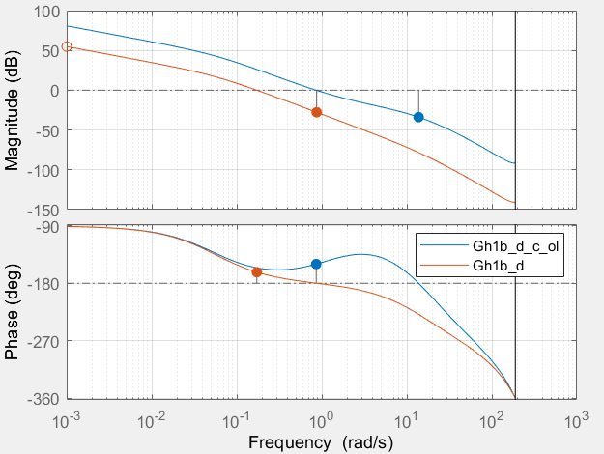
Simulation – Height Controller
Height Controller criterias
Plead
Easier to tune than PILead
Lead required due to 180 phase shift
Low kp gain
Less agressive reponse
Fairly high phase and gain margin
60 hz update rate
Notes:
Phase margin could be better but that gives a higher KP which leads to a more aggressive system (Not wanted for testing)
This is for height
High phase and gain because model does not fit reality

Slide 8
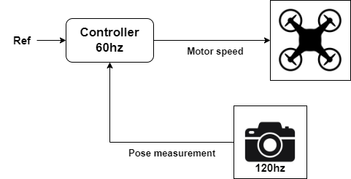
Simulation - Height Controller

Slide 9
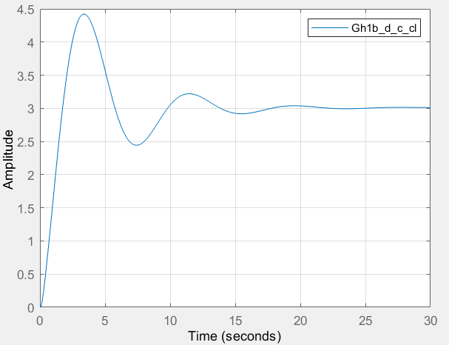
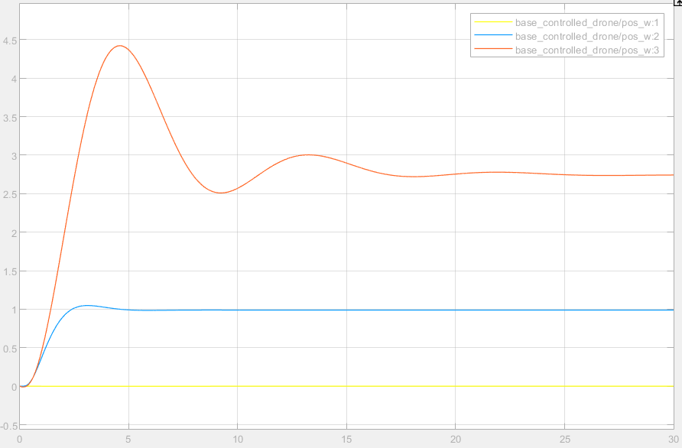
Simulation – Step response
Matlab TF step Simulink
Notes:
Left matlab step
Right simulink
Simulink is lower due to the assumption in left side that hover thrust is known.
Can be fixed by an I term

Slide 10
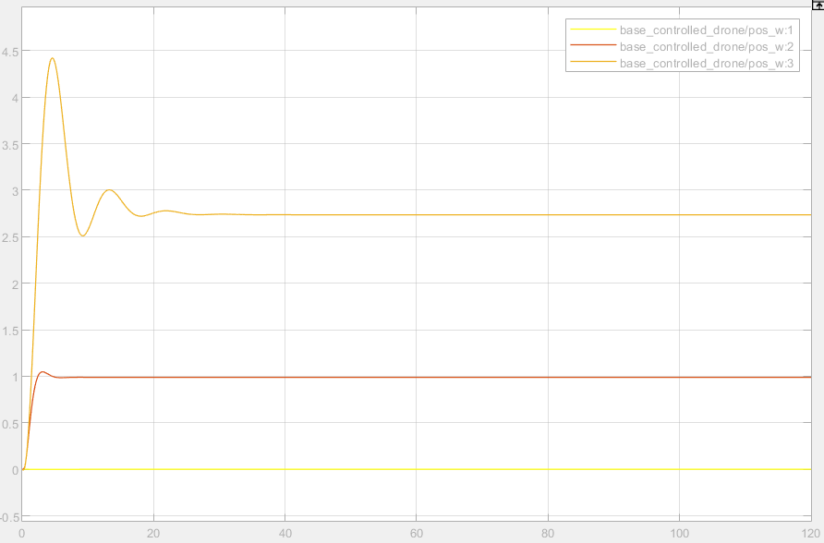
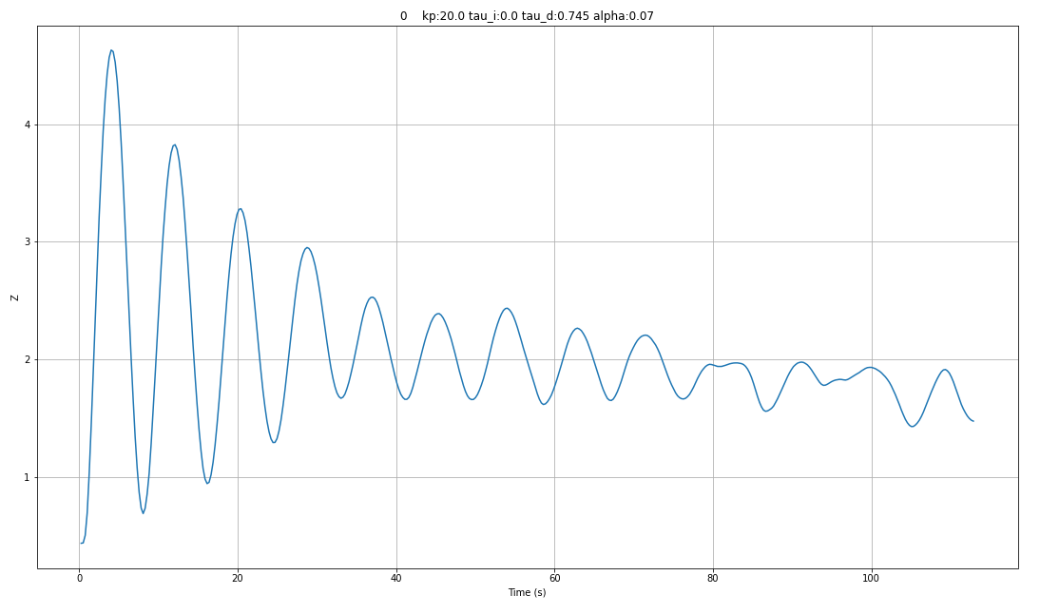
Real System
Simulation Real system

Slide 11
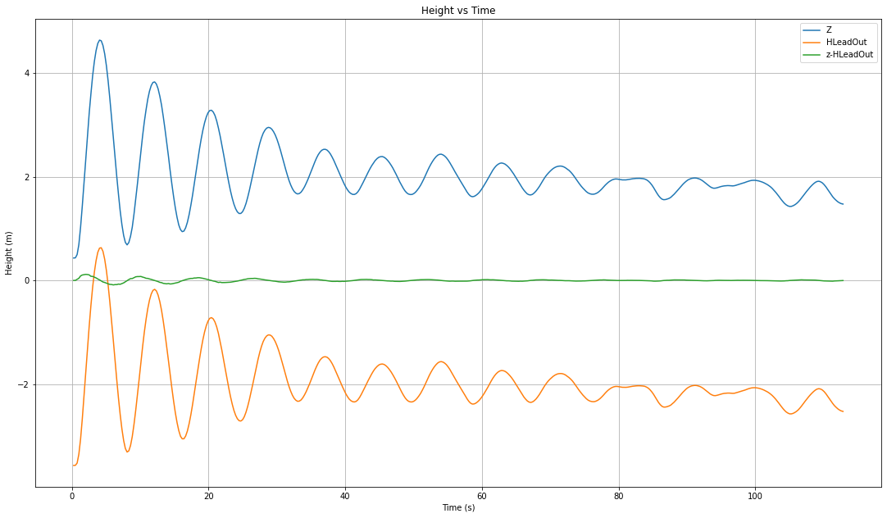
Real System

Slide 12
